Slide 1
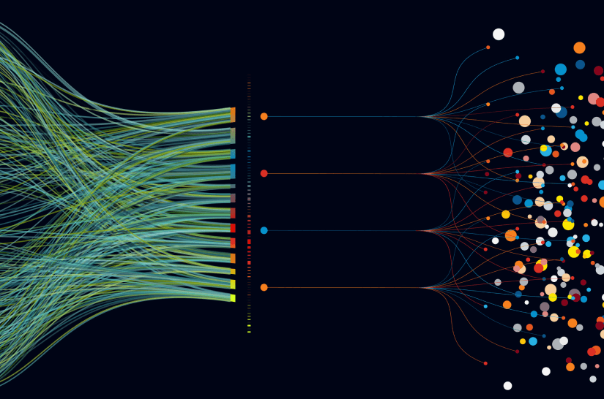
f
Project Management & Data Visualization Explained.
Tushar Sugandhi
Aneesh Sai Praneeth
Vikas Bhat

Slide 2


What is the concept of Project Management?
“A goal without a timeline is just a dream.”
– Robert Herjavec.
_________________________________________________
On a very basic level, project management includes the planning, initiation, execution, monitoring, and closing of a project.
Project management is used across industries and is an important part of the success of construction, engineering, and IT companies.
Project management uses a type of triage process to keep everything moving smoothly, on time, and on budget.

Slide 3
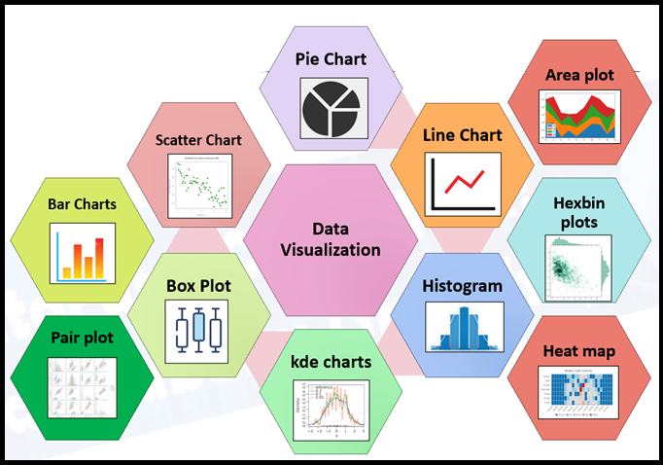
What about Data Visualization !?
“Measure the most you can and show the least you can.” – Danique Roefs
Data visualization is the representation of data through use of common graphics, such as charts, plots, infographics and even animations.
Types of Data Visualization Tools include:
→ Tables
→ Histograms
→ Scatter Plots
→ Heat Maps
and lots more…
_________________________________________________

Slide 4
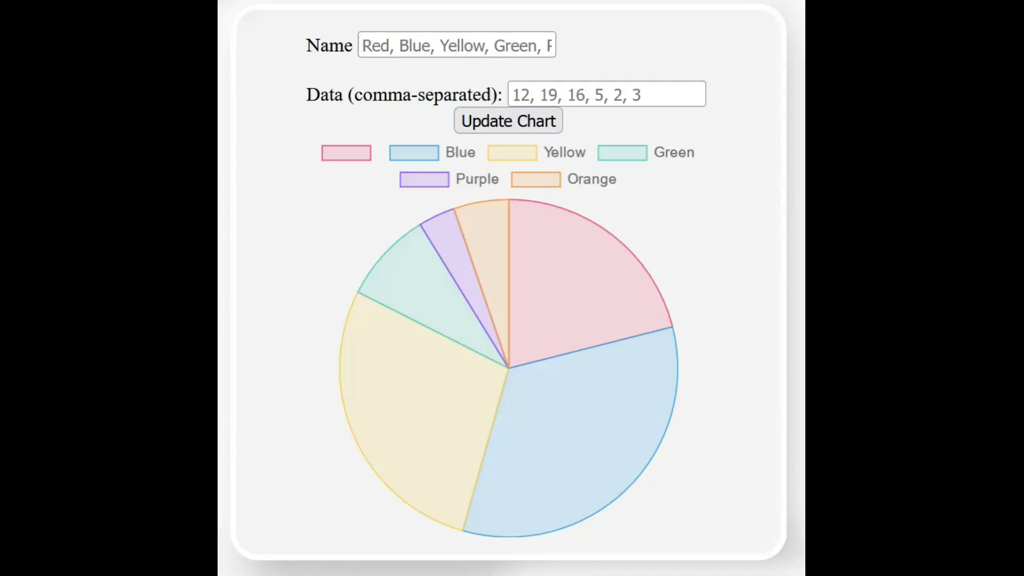
How does it Work ?

Slide 5
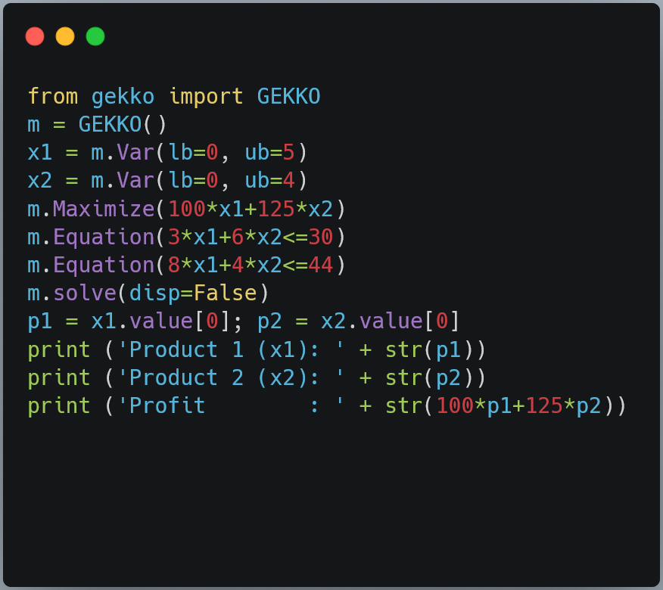
New Improvements in Mind…
Real-Time communication b/w employees using SOCKETS through UDP Network.
Live Progress indicator of existing sessions, projects & company/organization resources through various indicators.
Dynamic thought process when implementing new concepts as-per latest technological trends.
Improvements in UI/UX.

Slide 6

Thank You !!!!!!!!!!!!!

